Slide 1
Quantum Gates & Operators

Slide 2
Foreword: The importance & nature of quantum gates
Quantum applications are built as quantum circuits using quantum gates (like classical computer applications)
In classical computers, the gates are simple and appear only in architecture & computer organization courses
As for quantum computing, the gates are more complex and used directly in high level quantum applications (fore & front)
Due to the complexity of qubits, most of the quantum gates are mathematical and based linear and matrix algebra
In this lecture we describe samples of well known quantum gates used to build quantum applications

Slide 3
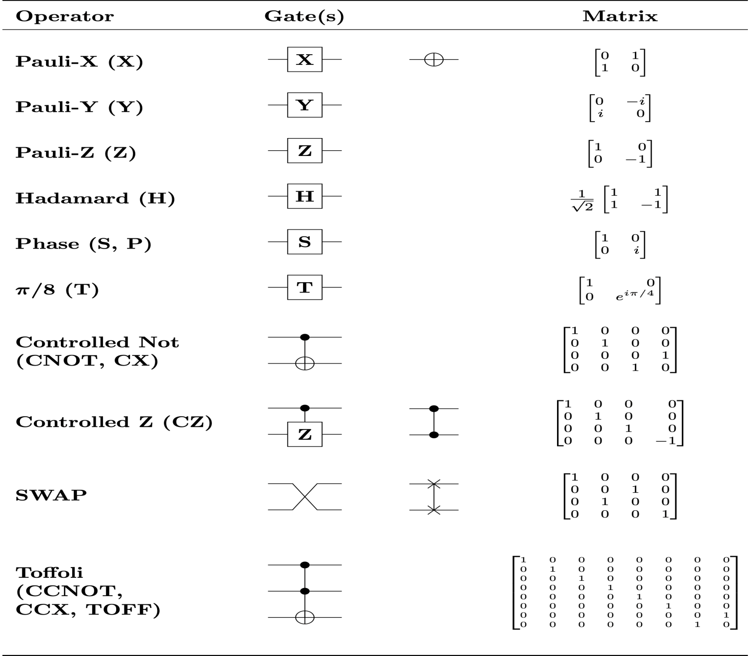

Slide 4
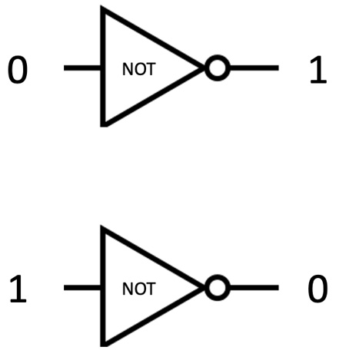
The Classical NOT Gate

Slide 5
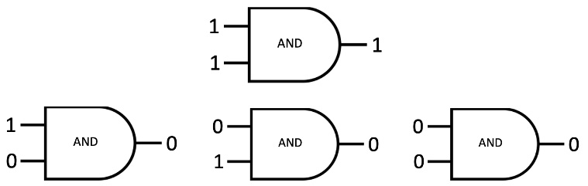
Classical AND gate

Slide 6
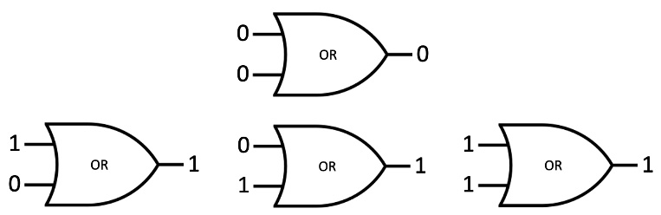
The Classical OR Gate

Slide 7
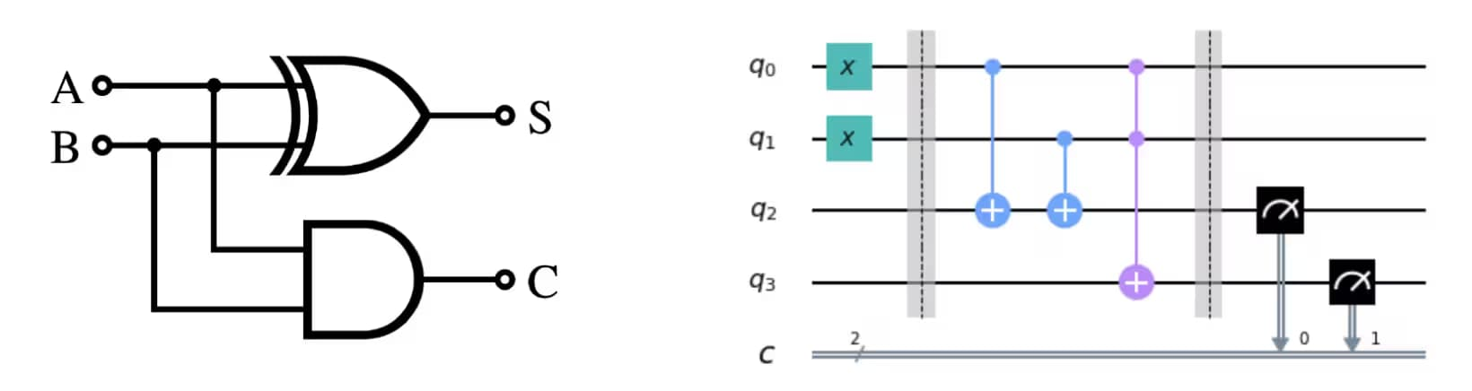
Two examples of Circuits: Classical VS Quantum

Slide 8
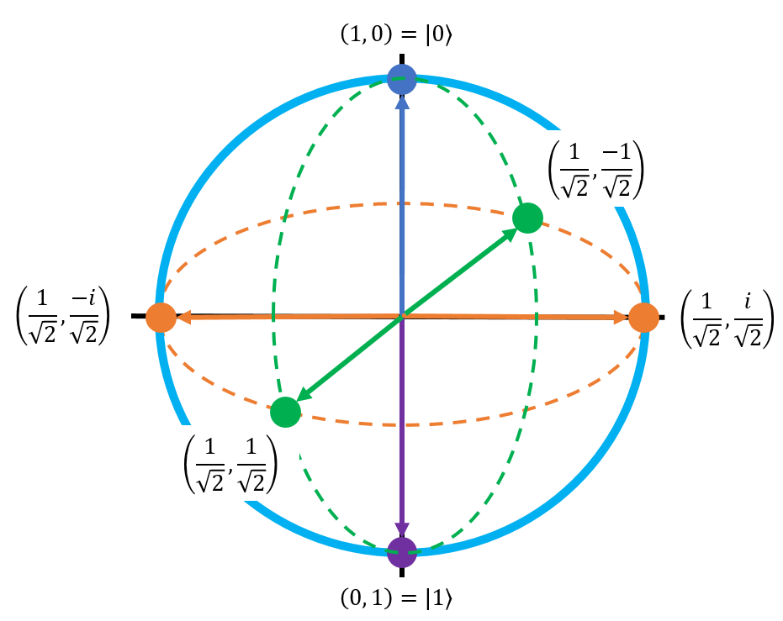
The Bloch Sphere
This nice simple figure on the right is Bloch Sphere
The Bloch Sphere is unitary figure used to represent
the state of a qubit
The vertical line in the middle is the Z axis (Pole axis)
The green line in the middle is the X axis
The orange arrow is the Y axis

Slide 9
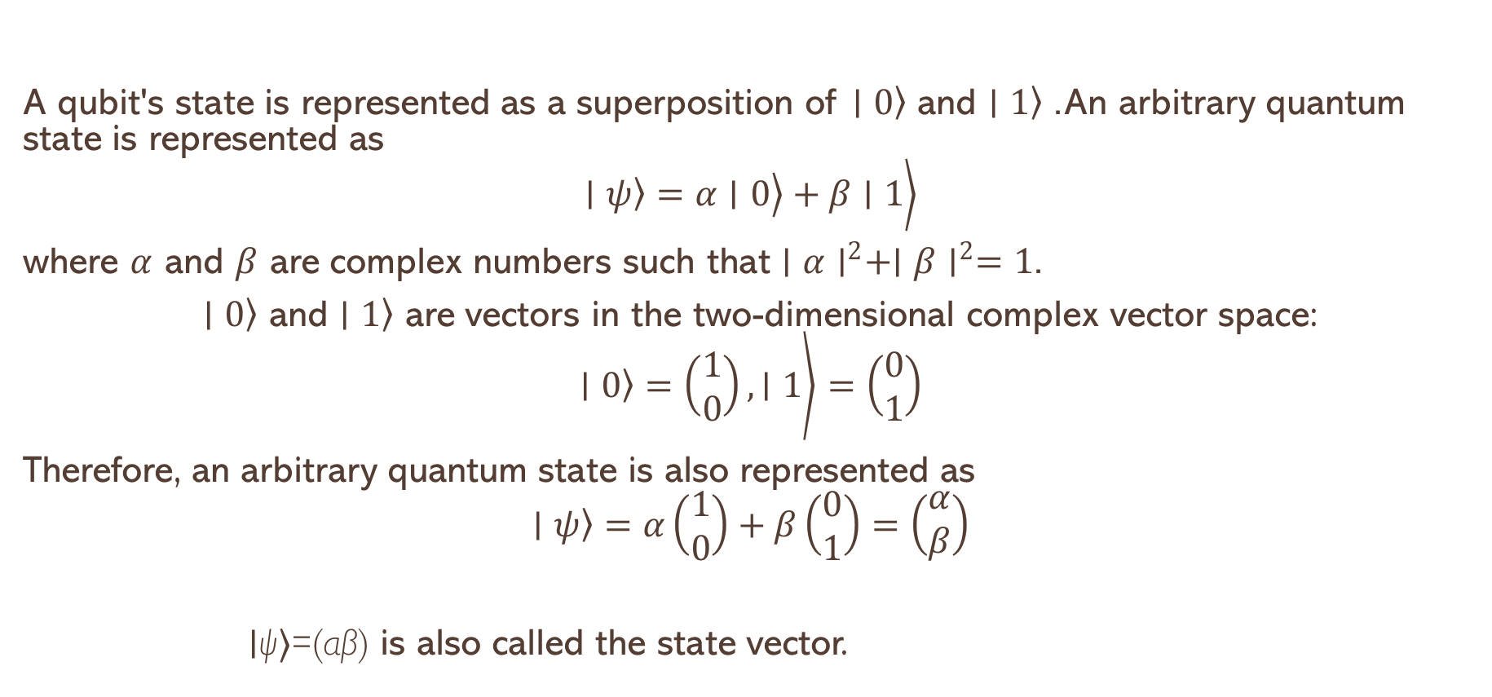
Quantum State and the Bloch Sphere
A qubit's state is represented as a superposition of $\left.∣0\right\rangle$ and $\left.∣1\right\rangle$. An arbitrary quantum state is represented as
$$\left.\left.\left.∣ψ\right\rangle =α∣0\right\rangle +β∣1\right\rangle$$
where $α$ and $β$ are complex numbers such that $∣α∣^{2}+∣β∣^{2}=1$.
$\left.∣0\right\rangle$ and $\left.∣1\right\rangle$ are vectors in the two-dimensional complex vector space:
$$\left.\left.∣0\right\rangle =\left(\begin{matrix}1 \\ 0\end{matrix}\right),∣1\right\rangle =\left(\begin{matrix}0 \\ 1\end{matrix}\right)$$
Therefore, an arbitrary quantum state is also represented as
$$\left.∣ψ\right\rangle =α\left(\begin{matrix}1 \\ 0\end{matrix}\right)+β\left(\begin{matrix}0 \\ 1\end{matrix}\right)=\left(\begin{matrix}α \\ β\end{matrix}\right)$$
∣ψ⟩=(αβ​) is also called the state vector.

Slide 10
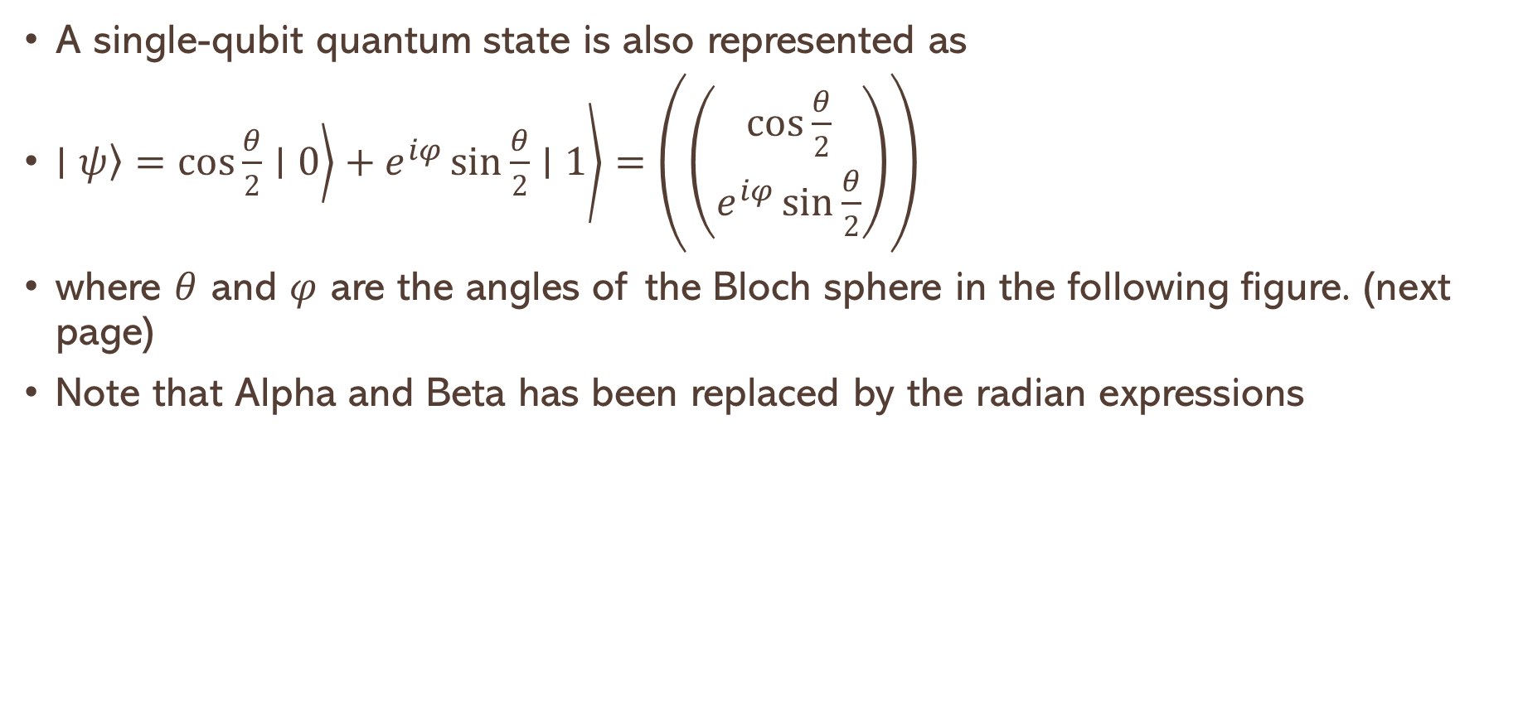
Using radian angles: the Bloch Sphere
A single-qubit quantum state is also represented as
$\left.\left.\left.∣ψ\right\rangle =\cos{\frac{θ}{2}}∣0\right\rangle +e^{iφ}\sin{\frac{θ}{2}}∣1\right\rangle =\left(\left(\begin{matrix}\cos{\frac{θ}{2}} \\ e^{iφ}\sin{\frac{θ}{2}}\end{matrix}\right)\right)$
where $θ$ and $φ$ are the angles of the Bloch sphere in the following figure. (next page)
Note that Alpha and Beta has been replaced by the radian expressions

Slide 11
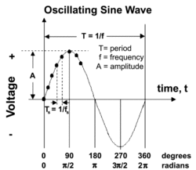
Some Concepts Regarding Waves

Slide 12
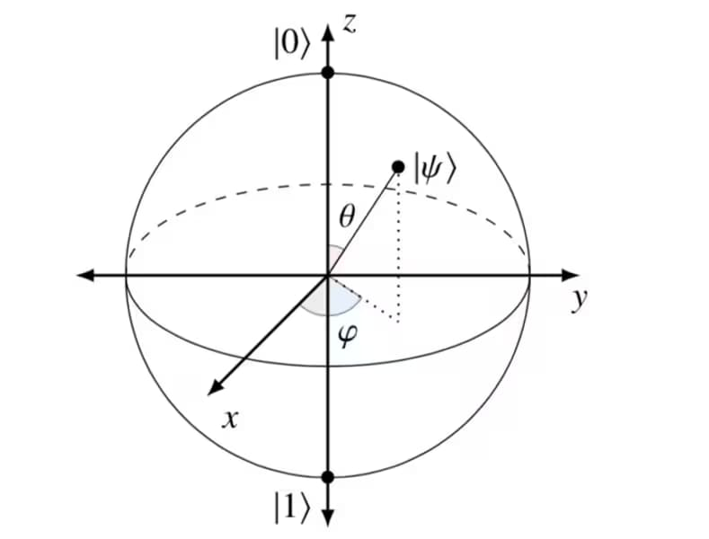
The Bare Bloch Sphere

Slide 13
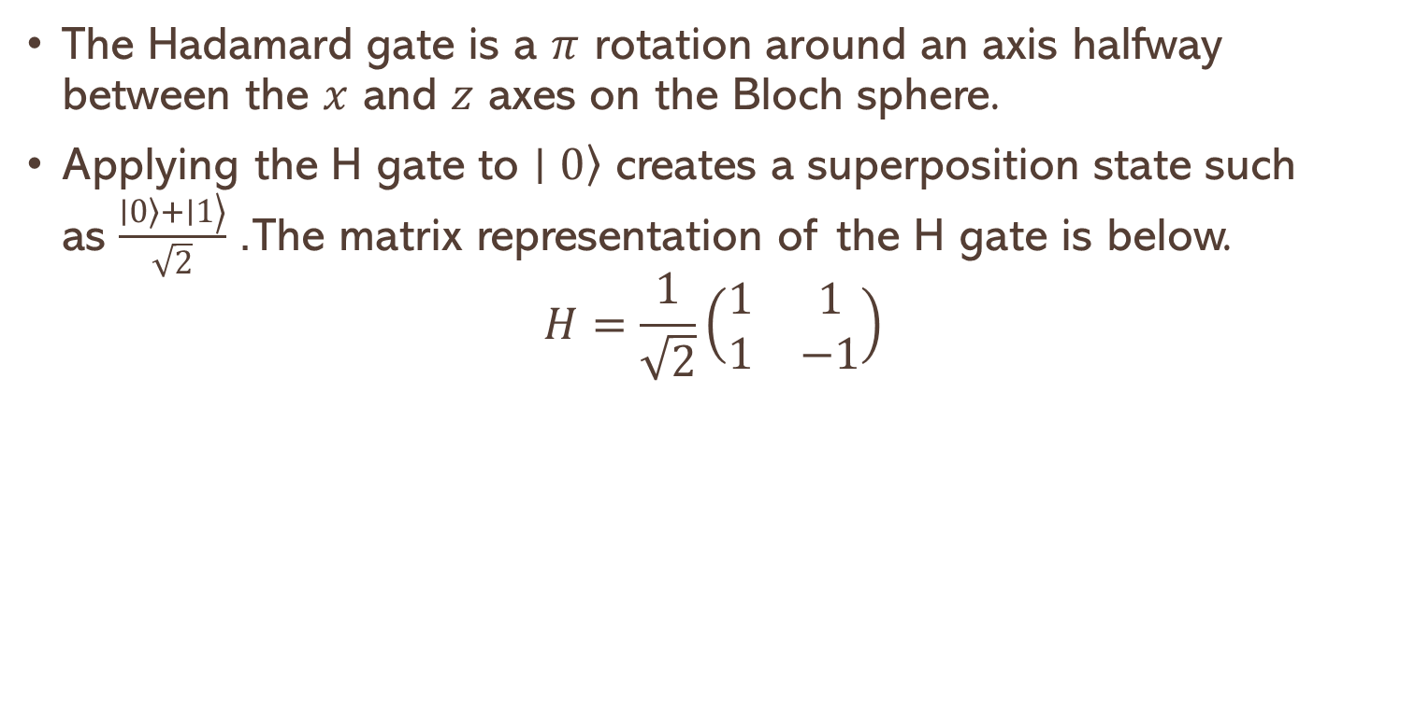
The Hadamard Gate
The Hadamard gate is a $π$ rotation around an axis halfway between the $x$ and $z$ axes on the Bloch sphere.
Applying the H gate to $\left.∣0\right\rangle$ creates a superposition state such as $\frac{\left.\left.∣0\right\rangle +∣1\right\rangle }{\sqrt{2}}$. The matrix representation of the H gate is below.
$$H=\frac{1}{\sqrt{2}}\left(\begin{matrix}1 & 1 \\ 1 & −1\end{matrix}\right)$$

Slide 14
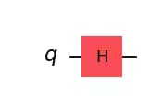
Apply the Hadamard Gate and Draw Circuit
qc = QuantumCircuit(1) # Create the single-qubit quantum circuit
# Apply an Hadamard gate to qubit 0
qc.h(0)
# Draw the circuit
qc.draw(output="mpl")
The Circuit:

Slide 15
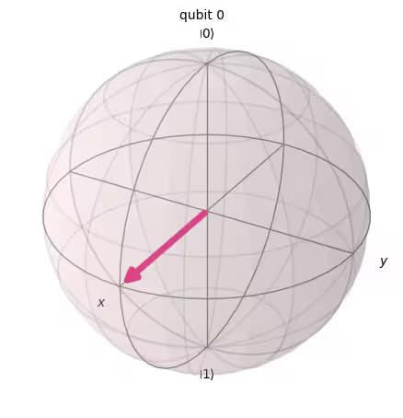


H on the Bloch Sphere : The $\left.∣+\right\rangle$state
# See the statevector
out_vector = Statevector(qc)
print(out_vector)
# Draw a Bloch sphere
plot_bloch_multivector(out_vector)
The $\left.\left.\left.∣+\right\rangle ≡\frac{1}{\sqrt{2}}\left(∣0\right\rangle +∣1\right\rangle \right)$
Statevector([0.70710678+0.j, 0.70710678+0.j],
dims=(2,))

Slide 16
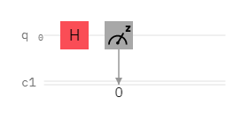
The Hadamard Gate Circuit

Slide 17
The Hamdard Gate in Action
from qiskit import QuantumCircuit, transpile, ClassicalRegister, QuantumRegister
from qiskit_aer import AerSimulator
backend = AerSimulator() # Using local Aer simulator
q = QuantumRegister(1,'q') # Initialise quantum register
c = ClassicalRegister(1,'c') # Initialise classical register
circuit = QuantumCircuit(q,c) # Initialise circuit
circuit.h(q[0]) # Put Qubit 0 in to superposition using hadamard gate
circuit.measure(q,c) # Measure qubit
circ = transpile(circuit, backend) # Rewrites the circuit to match the backend's basis gates and coupling map
shots = 1024 # Run and get counts
result = backend.run(circ,shots=shots).result()
counts = result.get_counts(circ)
print('RESULT: ',counts) # Print result

Slide 18
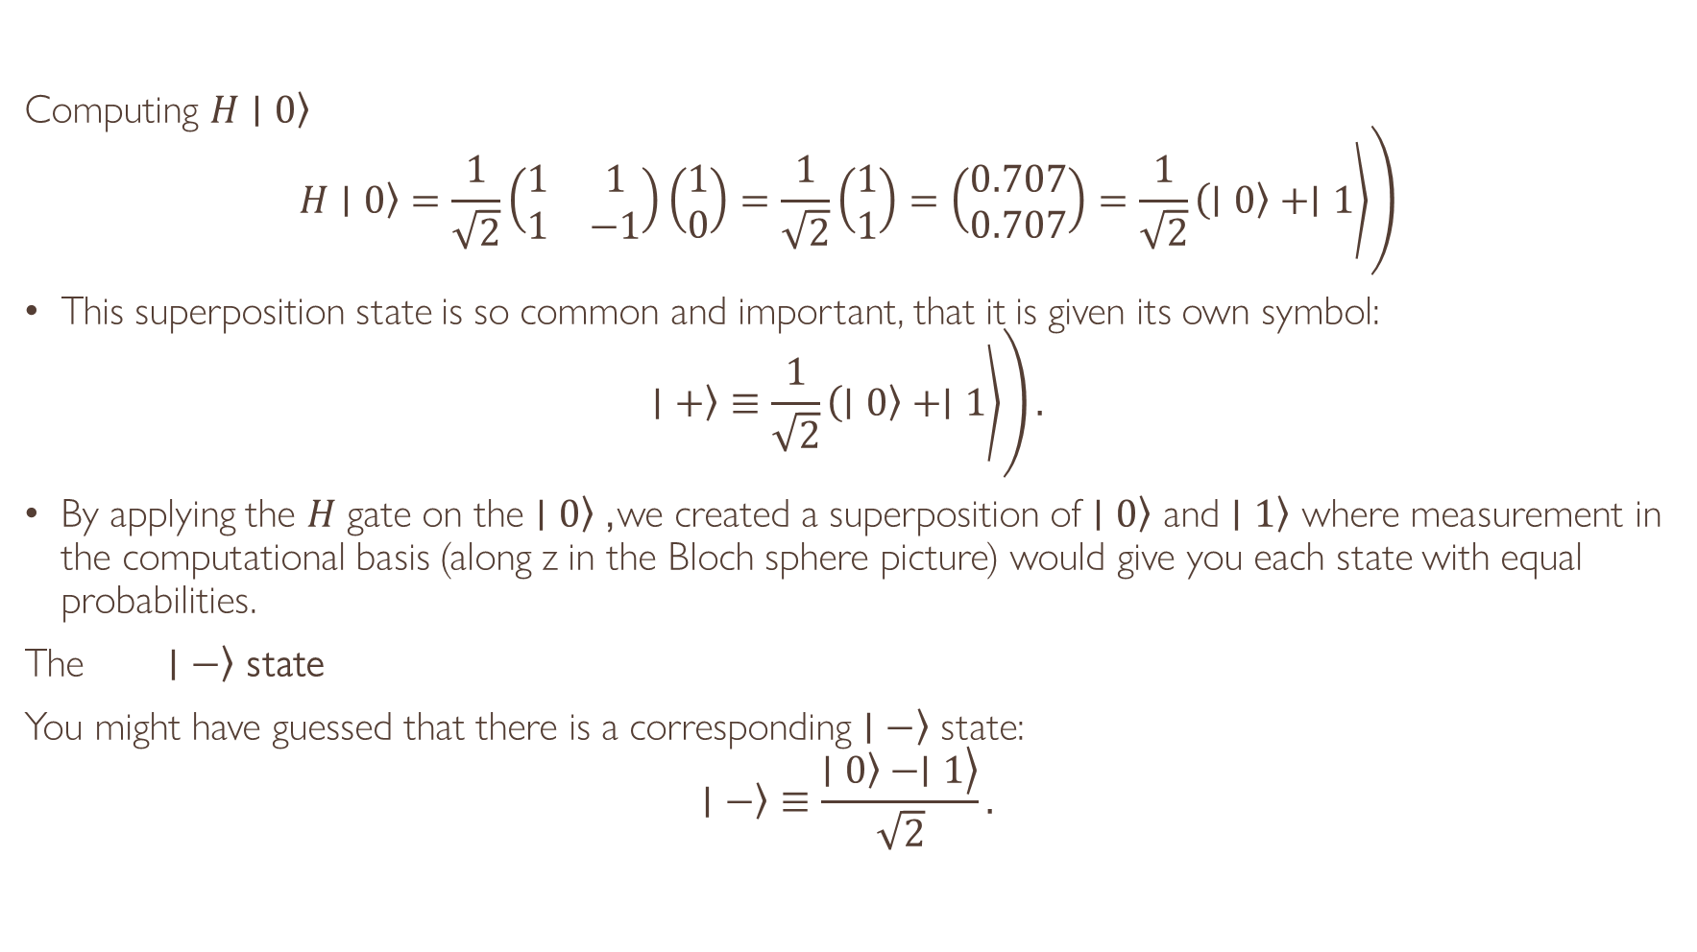
The H Gate
Computing $\left.H∣0\right\rangle$
$$\left.\left.\left.H∣0\right\rangle =\frac{1}{\sqrt{2}}\left(\begin{matrix}1 & 1 \\ 1 & −1\end{matrix}\right)\left(\begin{matrix}1 \\ 0\end{matrix}\right)=\frac{1}{\sqrt{2}}\left(\begin{matrix}1 \\ 1\end{matrix}\right)=\left(\begin{matrix}0.707 \\ 0.707\end{matrix}\right)=\frac{1}{\sqrt{2}}\left(∣0\right\rangle +∣1\right\rangle \right)$$
This superposition state is so common and important, that it is given its own symbol:
$$\left.\left.\left.∣+\right\rangle ≡\frac{1}{\sqrt{2}}\left(∣0\right\rangle +∣1\right\rangle \right).$$
By applying the $H$ gate on the $\left.∣0\right\rangle$, we created a superposition of $\left.∣0\right\rangle$ and $\left.∣1\right\rangle$ where measurement in the computational basis (along z in the Bloch sphere picture) would give you each state with equal probabilities.
The $\left. ∣−\right\rangle$ state
You might have guessed that there is a corresponding $\left.∣−\right\rangle$ state:
$$\left.∣−\right\rangle ≡\frac{\left.\left.∣0\right\rangle −∣1\right\rangle }{\sqrt{2}}.$$

Slide 19
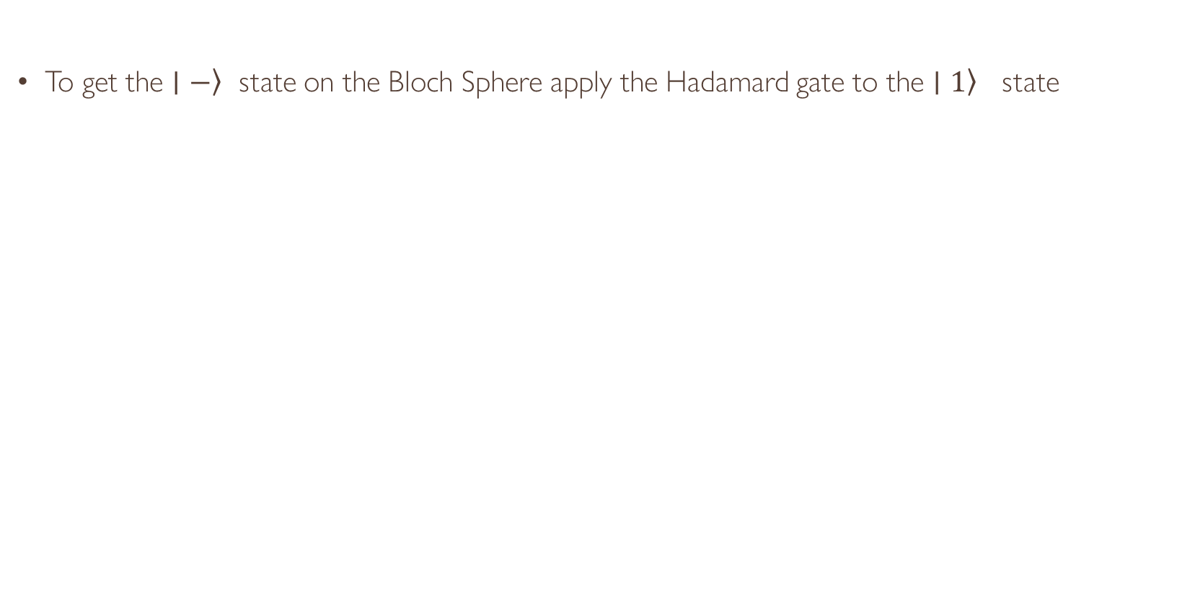

H on the Bloch Sphere: The $\left.∣−\right\rangle$ state
To get the $\left.∣−\right\rangle$ state on the Bloch Sphere apply the Hadamard gate to the $\left.∣1\right\rangle$ state

Slide 20
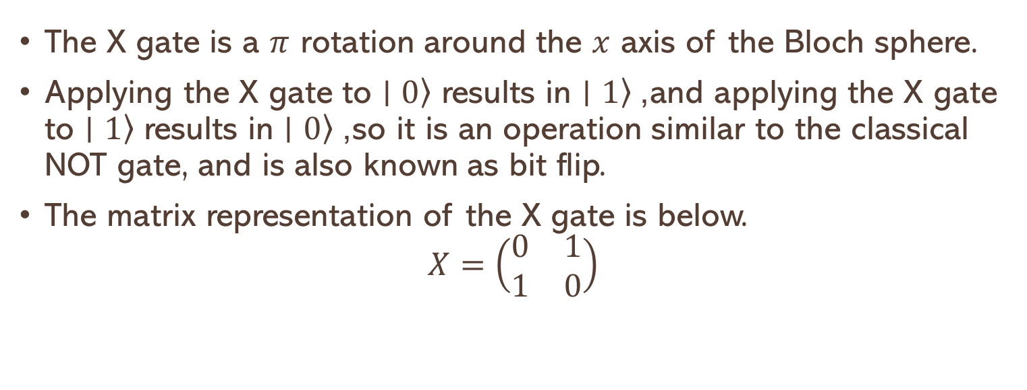
The X Gate (NOT Gate)
The X gate is a $π$ rotation around the $x$ axis of the Bloch sphere.
Applying the X gate to $\left.∣0\right\rangle$ results in $\left.∣1\right\rangle$, and applying the X gate to $\left.∣1\right\rangle$ results in $\left.∣0\right\rangle$, so it is an operation similar to the classical NOT gate, and is also known as bit flip.
The matrix representation of the X gate is below.
$$X=\left(\begin{matrix}0 & 1 \\ 1 & 0\end{matrix}\right)$$

Slide 21
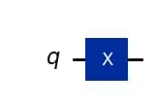
The X Gate Python Implementation
qc = QuantumCircuit(1) # Prepare the single-qubit quantum circuit
# Apply X gate to qubit 0
qc.x(0)
# Draw the circuit
qc.draw("mpl")
The X circuit diagram

Slide 22
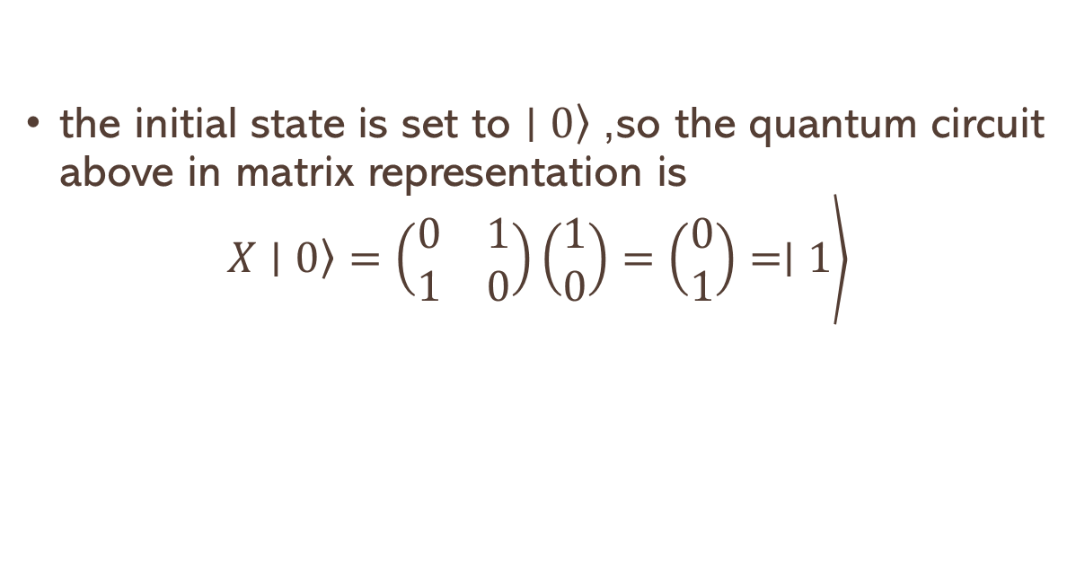
The X circuit operator
the initial state is set to $\left.∣0\right\rangle$, so the quantum circuit above in matrix representation is
$$\left.\left.X∣0\right\rangle =\left(\begin{matrix}0 & 1 \\ 1 & 0\end{matrix}\right)\left(\begin{matrix}1 \\ 0\end{matrix}\right)=\left(\begin{matrix}0 \\ 1\end{matrix}\right)=∣1\right\rangle$$

Slide 23
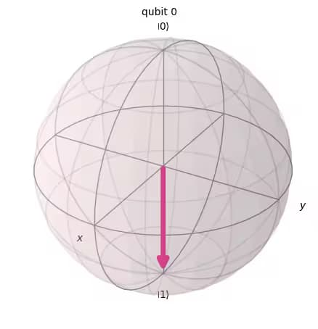
Drawing the Bloch Diagram
# See the statevector
out_vector = Statevector(qc)
print(out_vector)
# Draw a Bloch sphere
plot_bloch_multivector(out_vector)
Statevector([0.+0.j, 1.+0.j],
dims=(2,))

Slide 24
Pauli-Y Gate
Similarly to Pauli-X gate, the Y gate represents a rotation of around the y axis by π radians.
It transforms |0〉 to i|1〉 and |1〉 to -i|0〉.

Slide 25
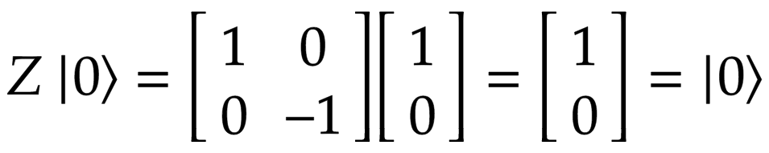
Pauli-Z Gate
The Z gate is actually a special case of the phase shift gate where 𝜙 = π = 180°.
It represents a rotation around the z axis by π radians.
It has no effect on |0〉 but transforms |1〉 to -|1〉.

Slide 26
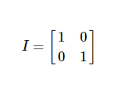
I-Gate
This is simply a gate that does nothing. Its matrix is the identity matrix.
circuit should have no effect on the qubit state.
It is often used in calculations, for example: proving the X-gate is its own inverse:
It is considering real hardware to specify a ‘do-nothing’ or ‘none’ operation.

Slide 27
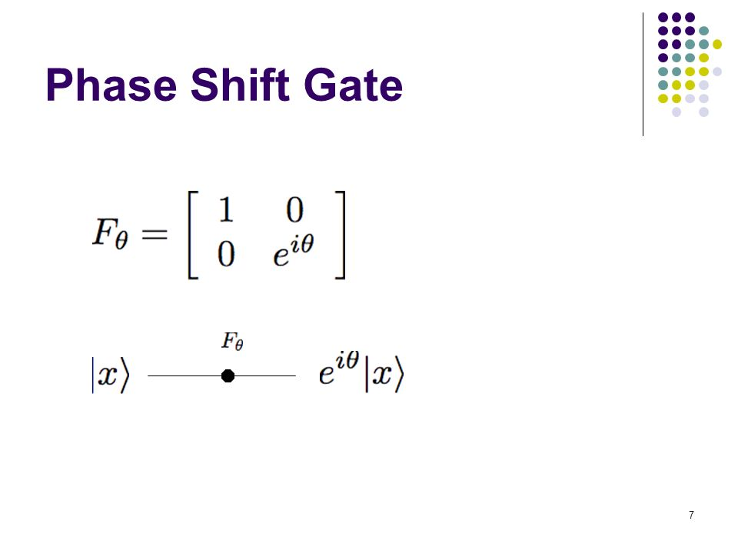
Phase Shifter Gate
This is a family of single-qubit gates that leave the basis state |0> unchanged and map |1> to e^iɸ|1>.
The probability of measuring a|0> or |1> is unchanged after applying this gate, however it modifies the phase of the quantum state.
This is equivalent to tracing a horizontal circle (a line of latitude) on the Bloch sphere by ɸ radians.

Slide 28
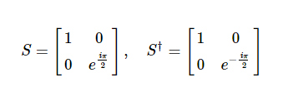
S and S† Gates
The Phase gate ( S gate) is a single-qubit operation.
The S gate is also known as the phase gate or the Z90 gate, because it represents a 90-degree rotation around the z-axis.
The conjugate transpose of S gate is S† gate.

Slide 29
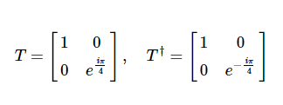
T and T† Gates
The T-gate is a very commonly used gate, it is an R_{ϕ}-gate with ɸ = π/4.
As with the S-gate, the T-gate is sometimes also known as (Z)^(1/4) gate.
The conjugate transpose of T gate is T† gate.

Slide 30
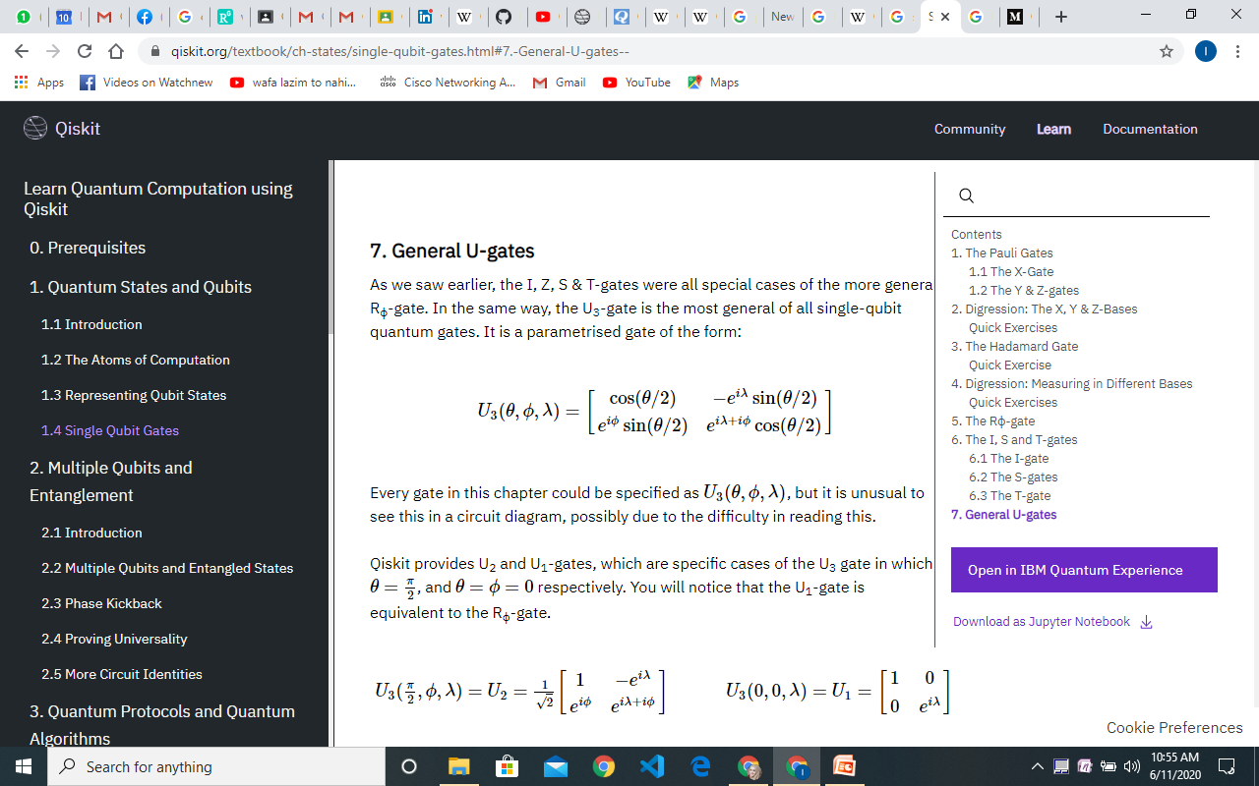
General U gates
Z, S & T-gates were all special cases of the more general R_{ϕ}-gate.
The U₃-gate is the most general of all single-qubit quantum gates.
It is a parameterized gate of the form:

Slide 31
Multiple Qubits Quantum Gates
Swap Gate
Controlled Gates
Toffoli (CCNOT) Gate
Fredkin (CSWAP) gate

Slide 32
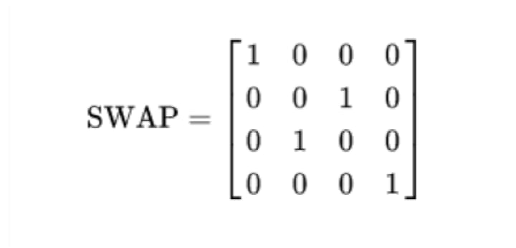

SWAP Gate
The swap gate swaps two qubits.
With respect to the basis |00> |01>, |10>, |11>.
It is represented by the matrix:

Slide 33
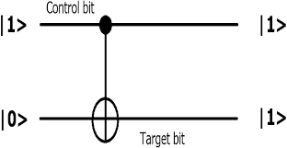
Controlled Gates
Controlled gates require at least one control and one target qubit.
The gate in question will only operate on the target qubit if the control qubit is in a specific state.
Types of control gates:
Cx Gate
Cy Gate
Cz Gate

Slide 34
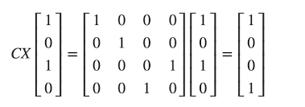
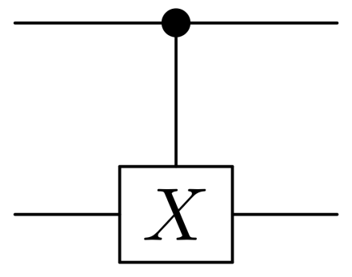
Cx Gate
Cx leaves the control qubit unchanged and performs a Pauli-X gate on the target qubit when the control qubit is in state |1⟩, leaves the target qubit unchanged when the control qubit is in state ∣0⟩.

Slide 35
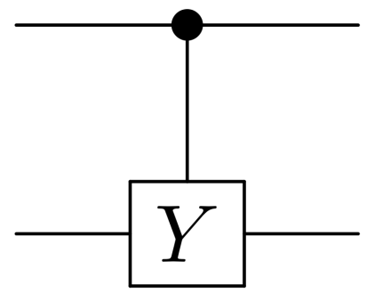
Cy Gate
The controlled or Cy gate is another well-used two-qubit gate.
Just as the CNOT applies an Y to its target qubit whenever its control is in state |1⟩, the controlled-Y applies a Y in the same case.

Slide 36
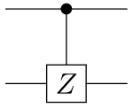
Cz Gate
The controlled-Z or Cz gate is another well-used two-qubit gate.
Just as the CNOT applies an X to its target qubit whenever its control is in state |1⟩, the controlled-Z applies a Z in the same case.

Slide 37
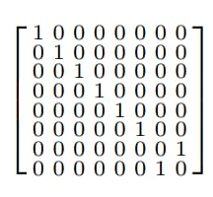
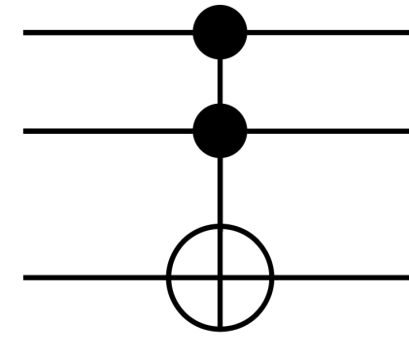
Toffoli Gate
The Toffoli gate is a three qubit gate with two controls and one target.
It performs an X on the target only if both controls are in the state |1⟩.
The final state of the target is then equal to either the AND or the NAND of the two controls, depending on whether the initial state of the target was |0⟩ or |1⟩.
A Toffoli can also be thought of as a controlled-controlled-NOT, and is also called the CCX gate.

Slide 38
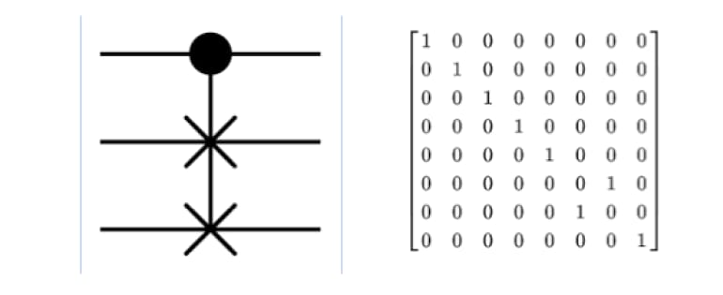
Fredkin Gate
It is controlled-SWAP gate.
It only swaps the values of the second and third bits only if the first bit is set to 1.
It is also a reversible gate.

Slide 39
A tool for visualization of Bloch Sphere
Please find a nice tool for visualizing and understanding Bloch Sphere representations
Bloch sphere visualizer

Slide 40
